Slide 1
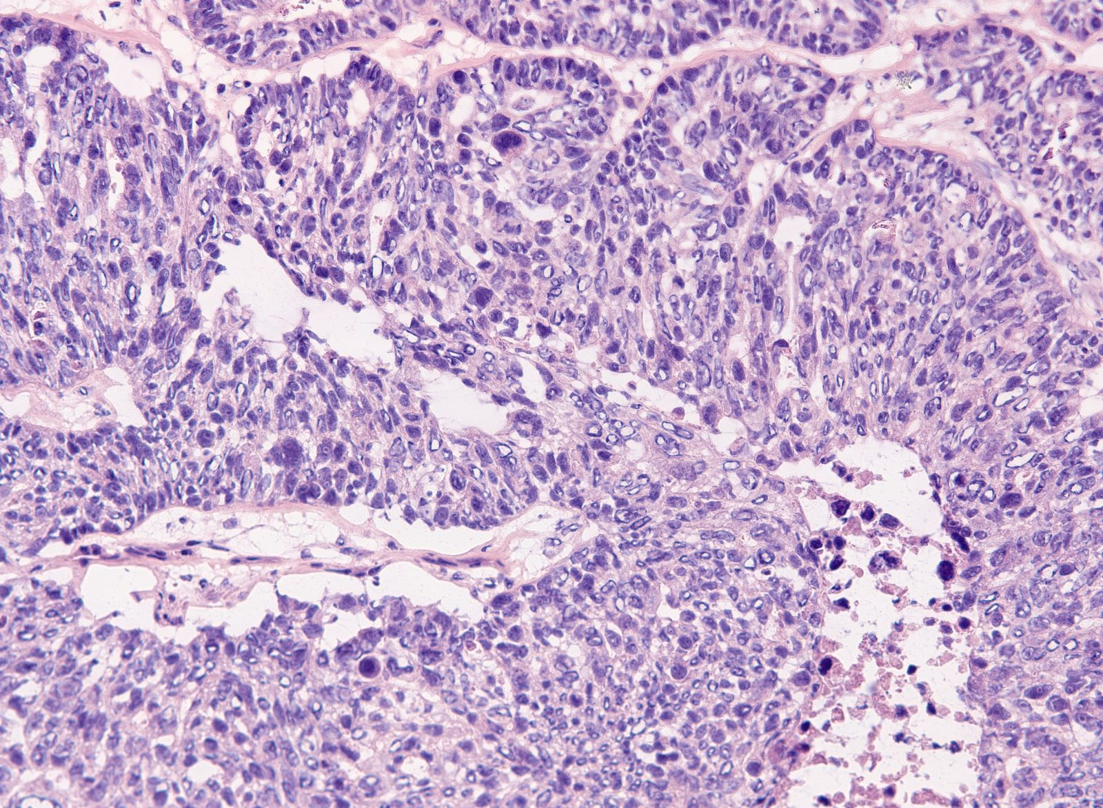
Evaluating the Accuracy of a Predictive Cancer Test

Slide 2

Many Ovarian Cancers Develop Genomic Instability
Genomic Instability is a feature of certain cancers and is caused by defective DNA repair, for example when the BRCA genes stop functioning
Why Measure Genomic Instability
A new class of drug is very effective at killing cancer cells that have Genomic Instability, but it is not toxic to normal cells.
Genomic Instability is now an important biomarker predicting benefit from these drugs. Patients whose tumors lack Genomic Instability will not benefit.
When BRCA1 or BRCA2 is lost, double strand breaks don’t get repaired properly

Slide 3
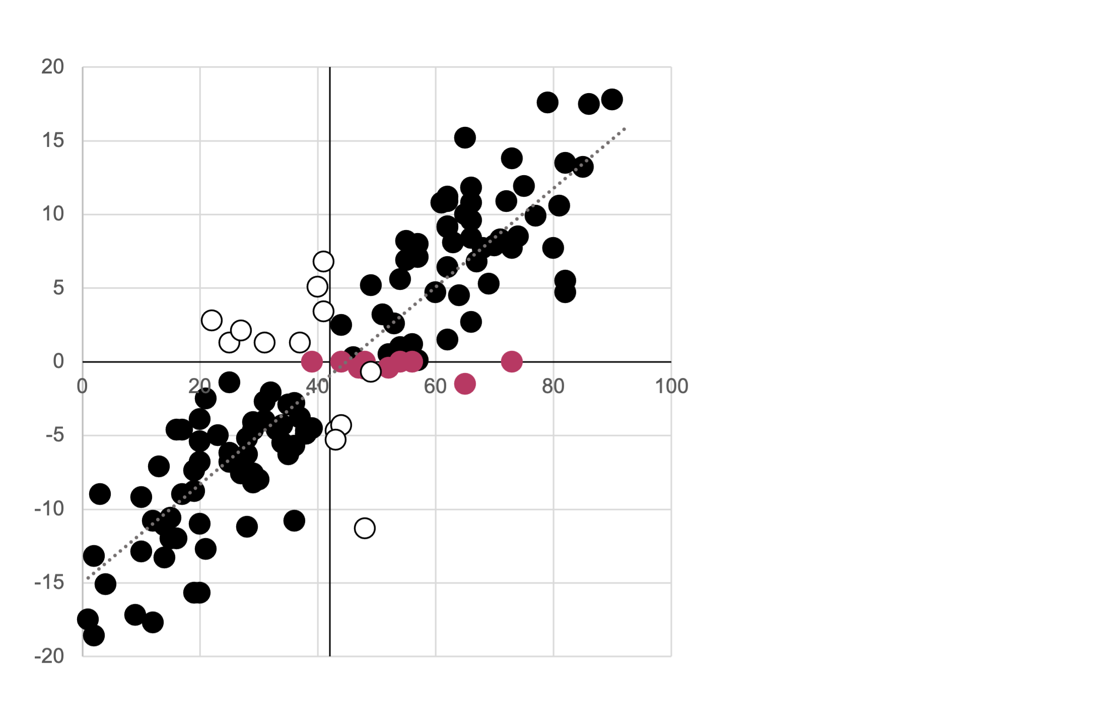
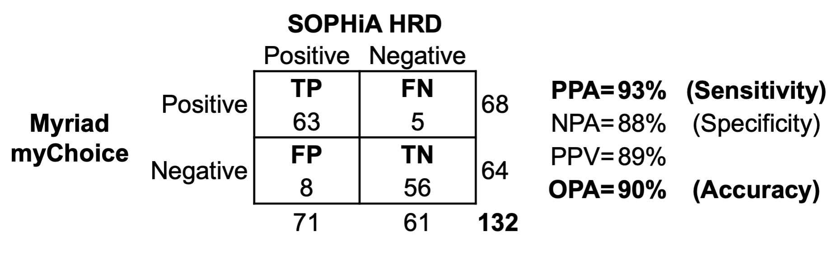
Tests that measure Genomic Instability are not 100% accurate
We compared a Genomic Instability test from SOPHiA Genetics with a reference test from Myriad Genetics
SOPHiA Genetics agreed with Myriad Genetics only 93% of the time
SOPHiA GI Index
Myriad GI Score

Slide 4
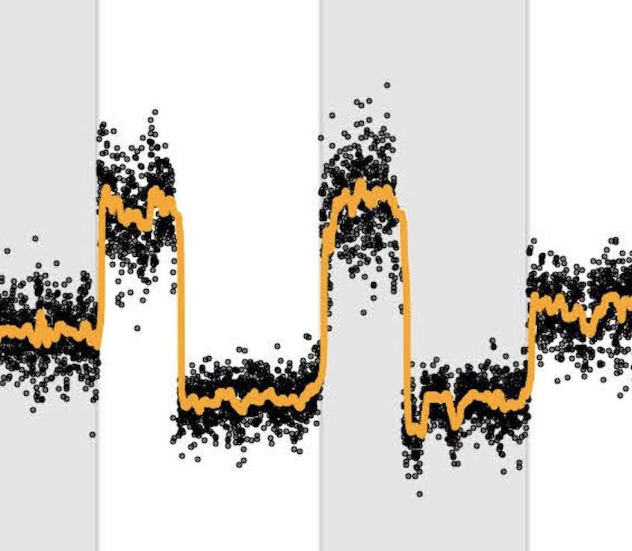
We asked, what characteristics of a test or sample is associated with disagreement?
Can we predict if a result generated by SOPHiA Genetics is at risk of being false without performing the Myriad Genetics reference test?
Each Myriad Genetics test generates several features that can be used to train a model that would help us accept or reject the cancer test result.
Normalized WGS coverage plot
Smoothed WGS coverage plot
The agreement, or lack of, between both tests, performed on our series of 139 ovarian cancer samples, can be used as the target for training our models.
Signal-Noise Ratio
Residual Noise
Signal
Purity-Ploidy Ratio

Slide 5

Methodology
Collect
Cleanse
Transform
Train
Predict
Data stored in .csv, .xlsx and .pdf file formats merged into a single .csv file using python scripts and loaded into MongoDB.
We prepared the data for training by dropping redundant columns, ensuring only numerical and categorical values and imputing missing values.
We transformed the data for machine learning by employing one-hot encoding and StandardScalar transformation
We employed two machine learning approaches.
TensorFlow local neural network employing PCA and kerastuner optimisation.
SciKitLearn random forest employing cross-validation training
We applied our models to an independent set of test results.

Slide 6
Database
Peter MacCallum
Data Set
Processing – scaling and PC
Report, Presentation
Mongo DB
Modelling NN and Random Forest
Mongo DB – used to store records.
Advantage:
Flexible regarding input files (CSV, JSON),
No formal schema - flexible as to structure and inputs as project evolved.
Hyperparameter tuning

Slide 7
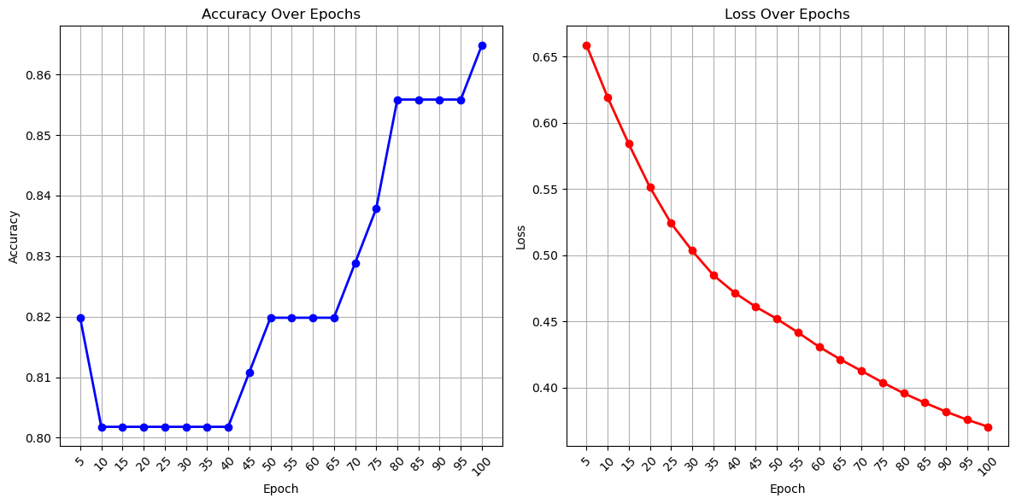
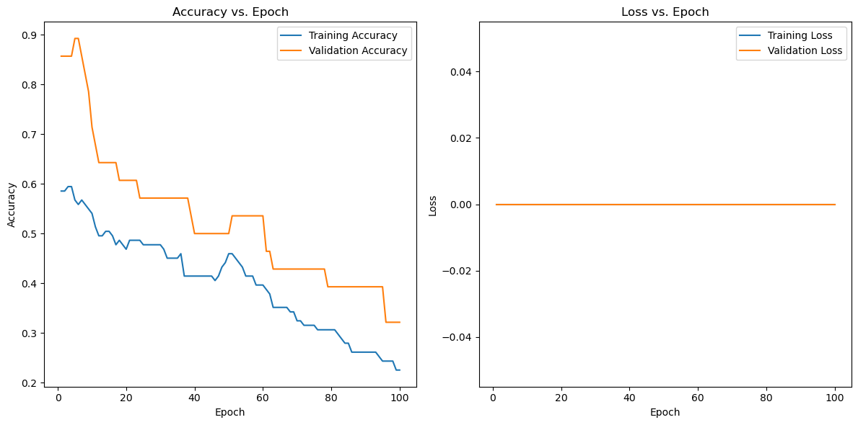
Neural Network Model
Our neural network was trained over epochs (generations) to maximise utility with respect to loss and accuracy.
Due to the spread of data in our limited predictive data set, the PCA model was adopted. This ensured that the dimensionality of training and predictive data would be equal and ensure the use of our model.

Slide 8
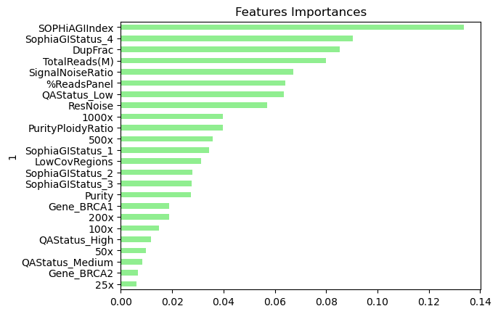
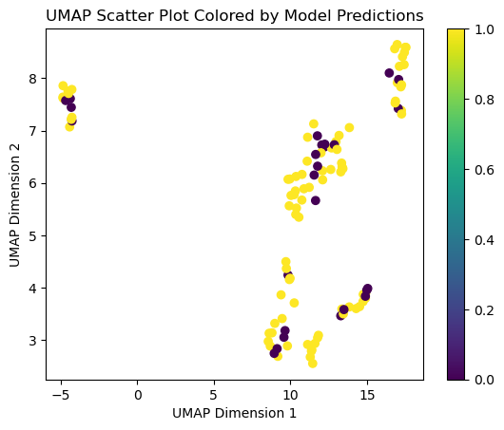
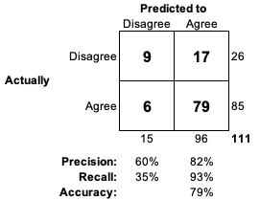
Random Forest Model
Random forest algorithm with cross-validation.
Advantages:
Better interpretability
Less likelihood of overfitting compared to neural network algorithms
Good at predicting correct test results
Poor at predicting incorrect test results
Using domain knowledge, we think minor features may be skewing this model.
Unsupervised learning using UMAP algorithm shows disagreement occurs throughout the data space

Slide 9
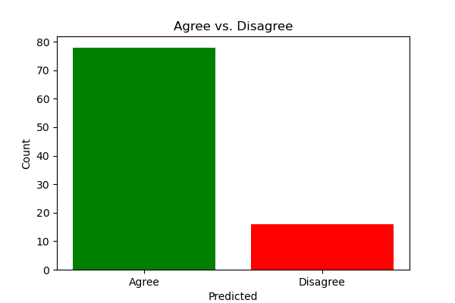
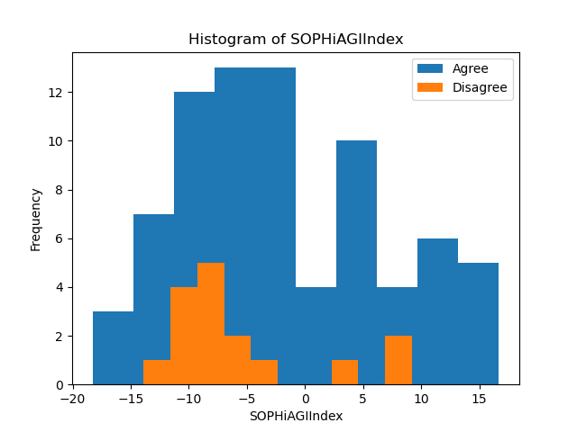
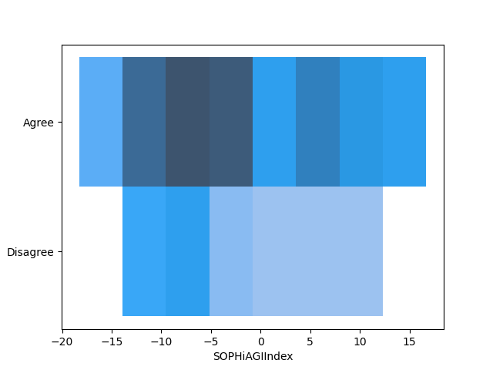
Random Forest predicted all results to be correct
Training Results and Predictions
We asked the models to predict if the SOPHiA test results were likely to be correct or incorrect.
We observe more predicted incorrect results with NN model compared to RF
On the right, we can visualise disagreement / agreement by our models on our training data using different plots:
Agree v Disagree
Stacked Histogram binned by SOPHiA GI result
Colour intensity representing count of samples
This shows –ve SOPHiA results are more likely to disagree – FN risk

Slide 10
Lessons learned and suggestions for Improvement
There are proven use cases where quality control of complex diagnostic test results is performed by machine learning.
Our neural network approach has potential but requires
larger training set
augmentation techniques
audit of input features
Our random forest approach lacked accuracy but is more explainable than the neural network model suggesting use of
logistic regression
support vector model

Slide 11

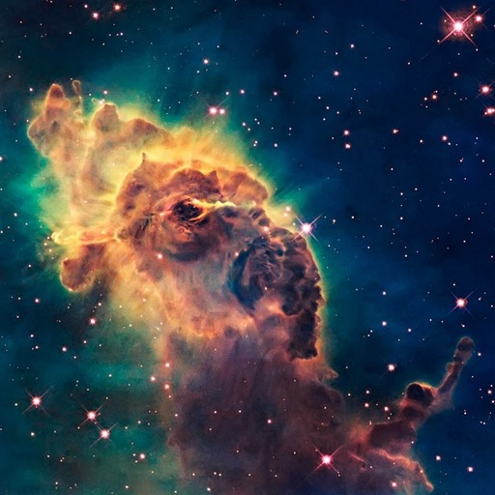


Thank you for listening We are: Andrew Fellowes Roberto Sammassimo Richard Soos Richard Thornton We are glad its over

Slide 12
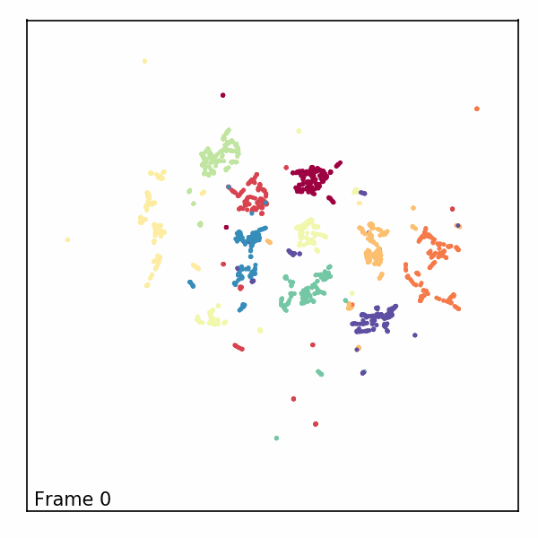
UMAP (Uniform Manifold Approximation and Projection)
https://github.com/lmcinnes/umap
UMAP is a fast general purpose dimension reduction algorithm like PCA that can handle large, high dimensional and sparse datasets.

